Slide 1
Product Training Program
Unit 5 – Data Mapper

Slide 2
Data Mapper Basics

Slide 3
What is the Data Mapper?
The PilotFish Data Mapper is a graphical, drag-and-drop three-pane mapping tool for building XSLT transformations without needing an expertise in XSLT syntax.
The Mapper provides the ability to load in the specifications of the source and target formats being mapped to use as guides for the mapping.
Mapping is accomplished by dragging and dropping nodes from the source panel (left) and target panel (right) onto the center panel.
All advanced XPath and XSLT functions are available in a tools palette (top) and can be accessed through the same drag-and-drop mechanism.
If a user wants to dive into the code, the graphical mapping generates standard XSLT, which can be viewed and edited via the XSLT tab. The code and the graphical view always stay in sync no matter what, changes in one automatically update in the other.
The Mapper also includes a full testing suite in its Testing tab, which allows rapid testing of the mapping as it is being built.

Slide 4
Creating Mappings
To create a new mapping, simply open the Data Mapper from within a PilotFish eiConsole Route’s XSLT Transformation panel.
To edit an existing mapping, one can be opened from the same location.

Slide 5
Format Builders

Slide 6
What are Format Builders?
To help with performing the mappings, the Data Mapper allows the user to define source and target formats. These formats are graphical representations of the XML documents being mapped in the XSLT transformation.
Formats are built using Format Builders, which load in external files and generate the graphical representation of the XML.
XML-based formats can be loaded simply through the use of the XML & XSD Format Builders.
Specific XML schemas, like ACORD and FHIR, have their own unique Format Builders with special features for those schemas.
Non-XML based formats can be loaded using a variety of other Format Builders for those specific file types. HL7 and Microsoft Excel are examples of some of these.
All Format Builders correspond to the automated PilotFish Transformation Modules. A transformer that automatically converts data to/from XML and a Format Builder for that same format will always produce the same XML structure, providing a guarantee that the format worked with in the Data Mapper will work with the Transformers.

Slide 7
Format Builders – Special Features

Slide 8
Special Features of Format Builders
When loading XSD schemas, all documentation becomes available as popup tooltips for each element in the Format tree.
For special formats like HL7, a large amount of metadata is bundled with the application. Descriptions of fields, acceptable coded values, etc, are all available for reference in the bottom part of the Format Panel.

Slide 9
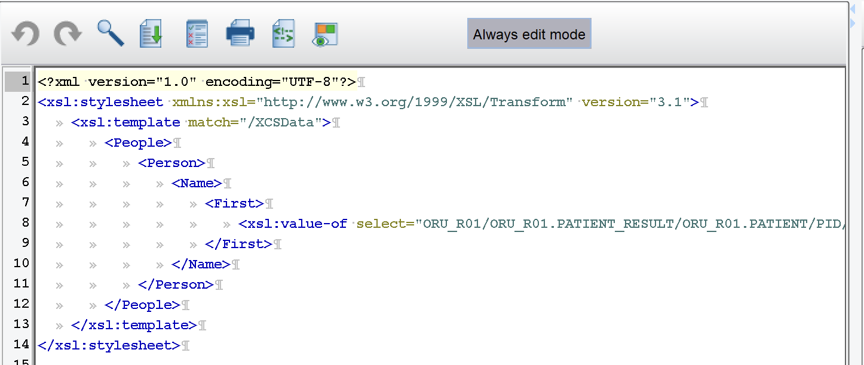
Doing Mapping

Slide 10
How to Map
Mapping in the Data Mapper is as simple as dragging nodes from the source and target panels onto the center panel.
Since XSLT is about building the target structure, the general flow of mapping tends to involve dropping target elements onto the center panel to build the mapping, and then dropping source elements on top of them to map their values to the targets.
As a mapping is built via drag-and-drop, checking the XSLT tab in the Data Mapper will reveal that a fully standard XSLT document is being built by the drag-and-drop operation.
Generally, dropping a source element onto a target element will create an implicit <xsl:value-of select=“expression” /> element in the XSLT, with the expression pre-populated with the XPath to the source element.

Slide 11
Using Target Format as Template
Because XSLT mappings are designed to build a target, output XML document, it can sometimes to be helpful to populate the entire target format onto the mapping at once.
The “Add Target Sample Data as Template” option in the Data Mapper does just that, it will populate the entire target format at once, which can then be used to do the necessary mapping.

Slide 12
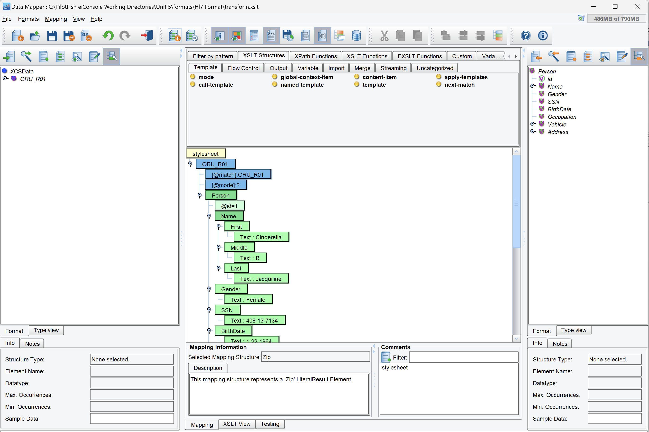
Tools Palette

Slide 13
Data Mapper Tools Palette
XSLT and XPath have a variety of advanced functions, complex elements, flow-control structures, extensions, and other tools for building complex mappings.
All of this, plus a few PilotFish specific goodies, are all available in the tools panel, located above the center mapping.
Organized into categories in tabs, they are also accessible via the quick search box.
Using any of these features is as simple as dragging-and-dropping, same as the rest of the mapping.
The tools palette items tend to be restricted to only being dropped in places where they are allowed based on the XSLT specification, so there never needs to be concern about using any of these things improperly.

Slide 14
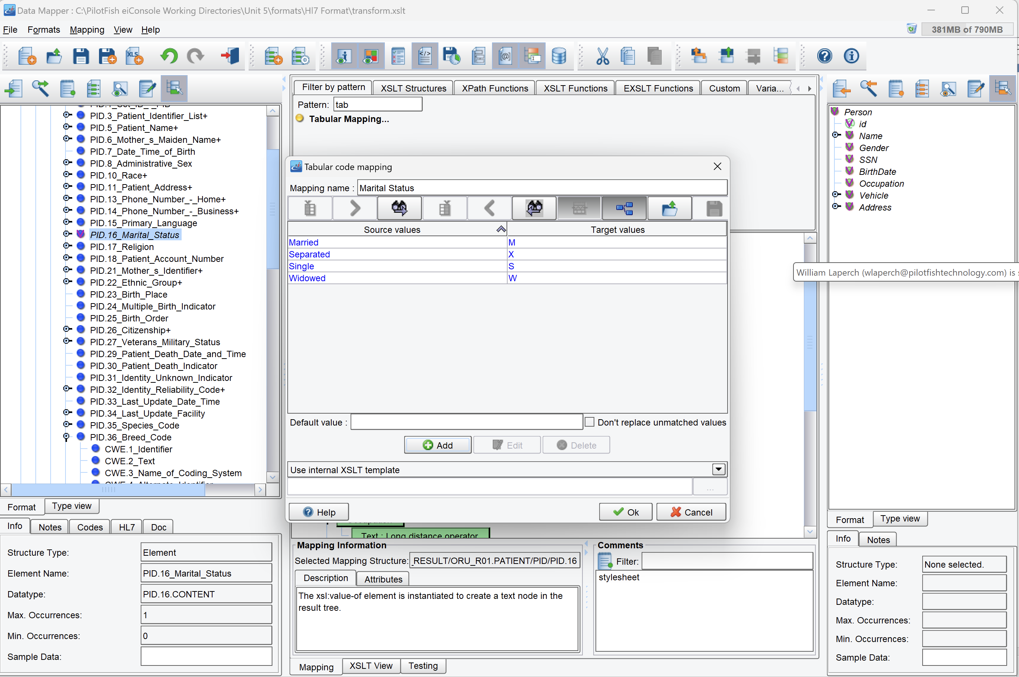
Tabular Mappings

Slide 15
What is a Tabular Mapping?
A Tabular Mapping is a shortcut for creating an XSLT Template that uses a Choose statement to replace values.
Like all Data Mapper tools, it can be found in the top tools palette. It can only be dropped onto a mapped source node with the value that is going to be converted using the Tabular Mapping.
It specifies a series of input values, and maps them to their corresponding output values.
This simple graphical tool allows each value mapping to be quickly configured, and then automatically builds the XSLT template needed for it. It then adds a call to that template to retrieve the value to the code at the point it was dropped on.

Slide 16
XML & XSLT Structures in the Data Mapper

Slide 17
Namespaces
For the most part, namespaces are automatically handled by the Data Mapper on an as-needed basis.
If the source or target format has a namespace, it is populated as soon as the first node is dropped onto the center mapping panel.
If any functions, extensions, etc, from the tools panel require special namespaces, they are populated automatically as soon as that particular item is dragged onto the center mapping panel.

Slide 18
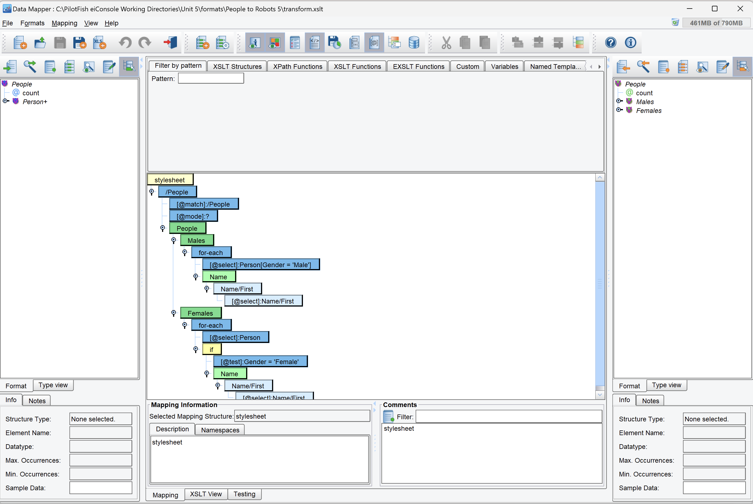
Predicates

Slide 19
Predicates
XPath Predicates still need to be manually entered into XPath expressions. However, doing so is quite simple.
Whenever a source element is dropped onto the center mapping panel, a full XPath expression minus any predicates is created. That XPath expression can be edited by double-clicking on the “@select” node in the mapping to open a text field.
Simply add the predicate wherever it needs to go, and press Enter to save the changes.

Slide 20
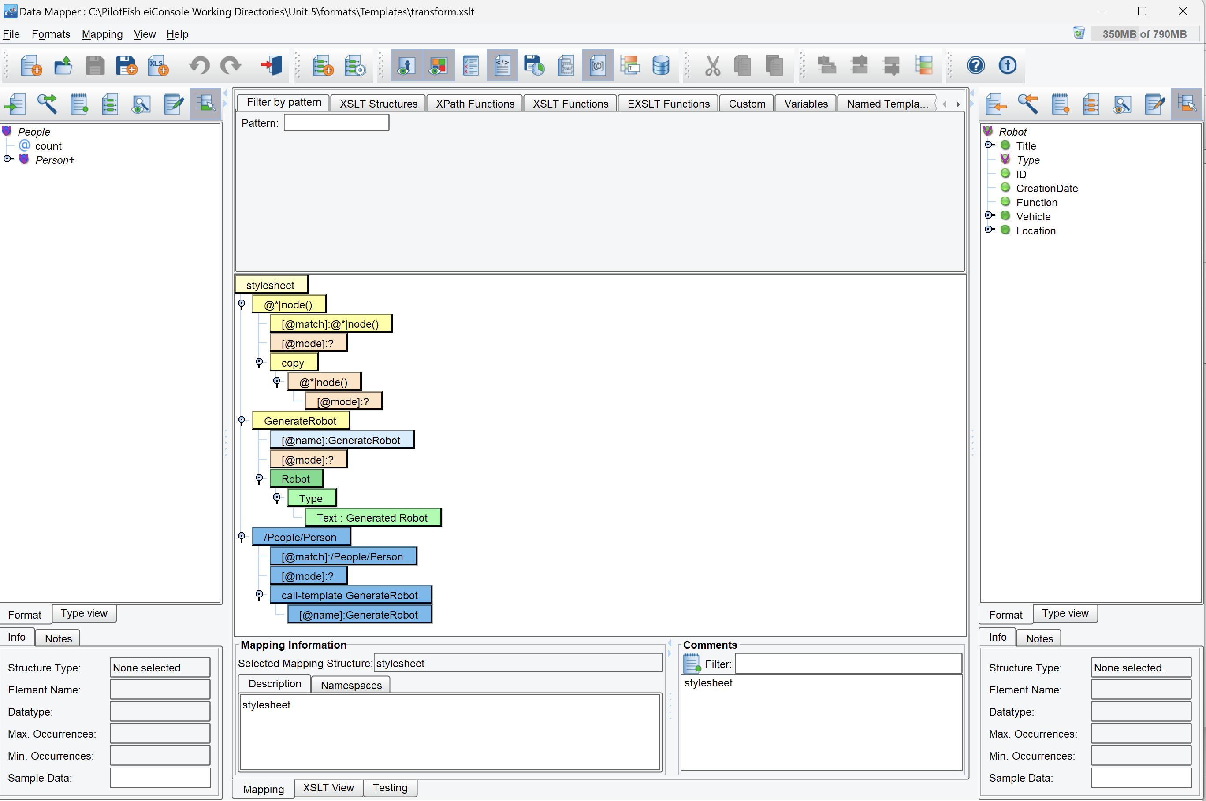
Templates

Slide 21
Templates
Templates can be created in two ways, one for the “root” template, and one for other templates.
The “root”, or first, template, is created by a simple drag-and-drop from the source and target formats. The root element of the source format is dragged first onto the Stylesheet element, and the root element of the target format is dragged on top of it. This implicitly creates the root template in the XSLT.
Other templates can be created using the tools palette. Both regular templates that match on XPath expressions, and named templates that are invoked by their name, can be created here.
Other template-related expressions, such as call-template and apply-templates, can also be found in the tools palette.

Slide 22
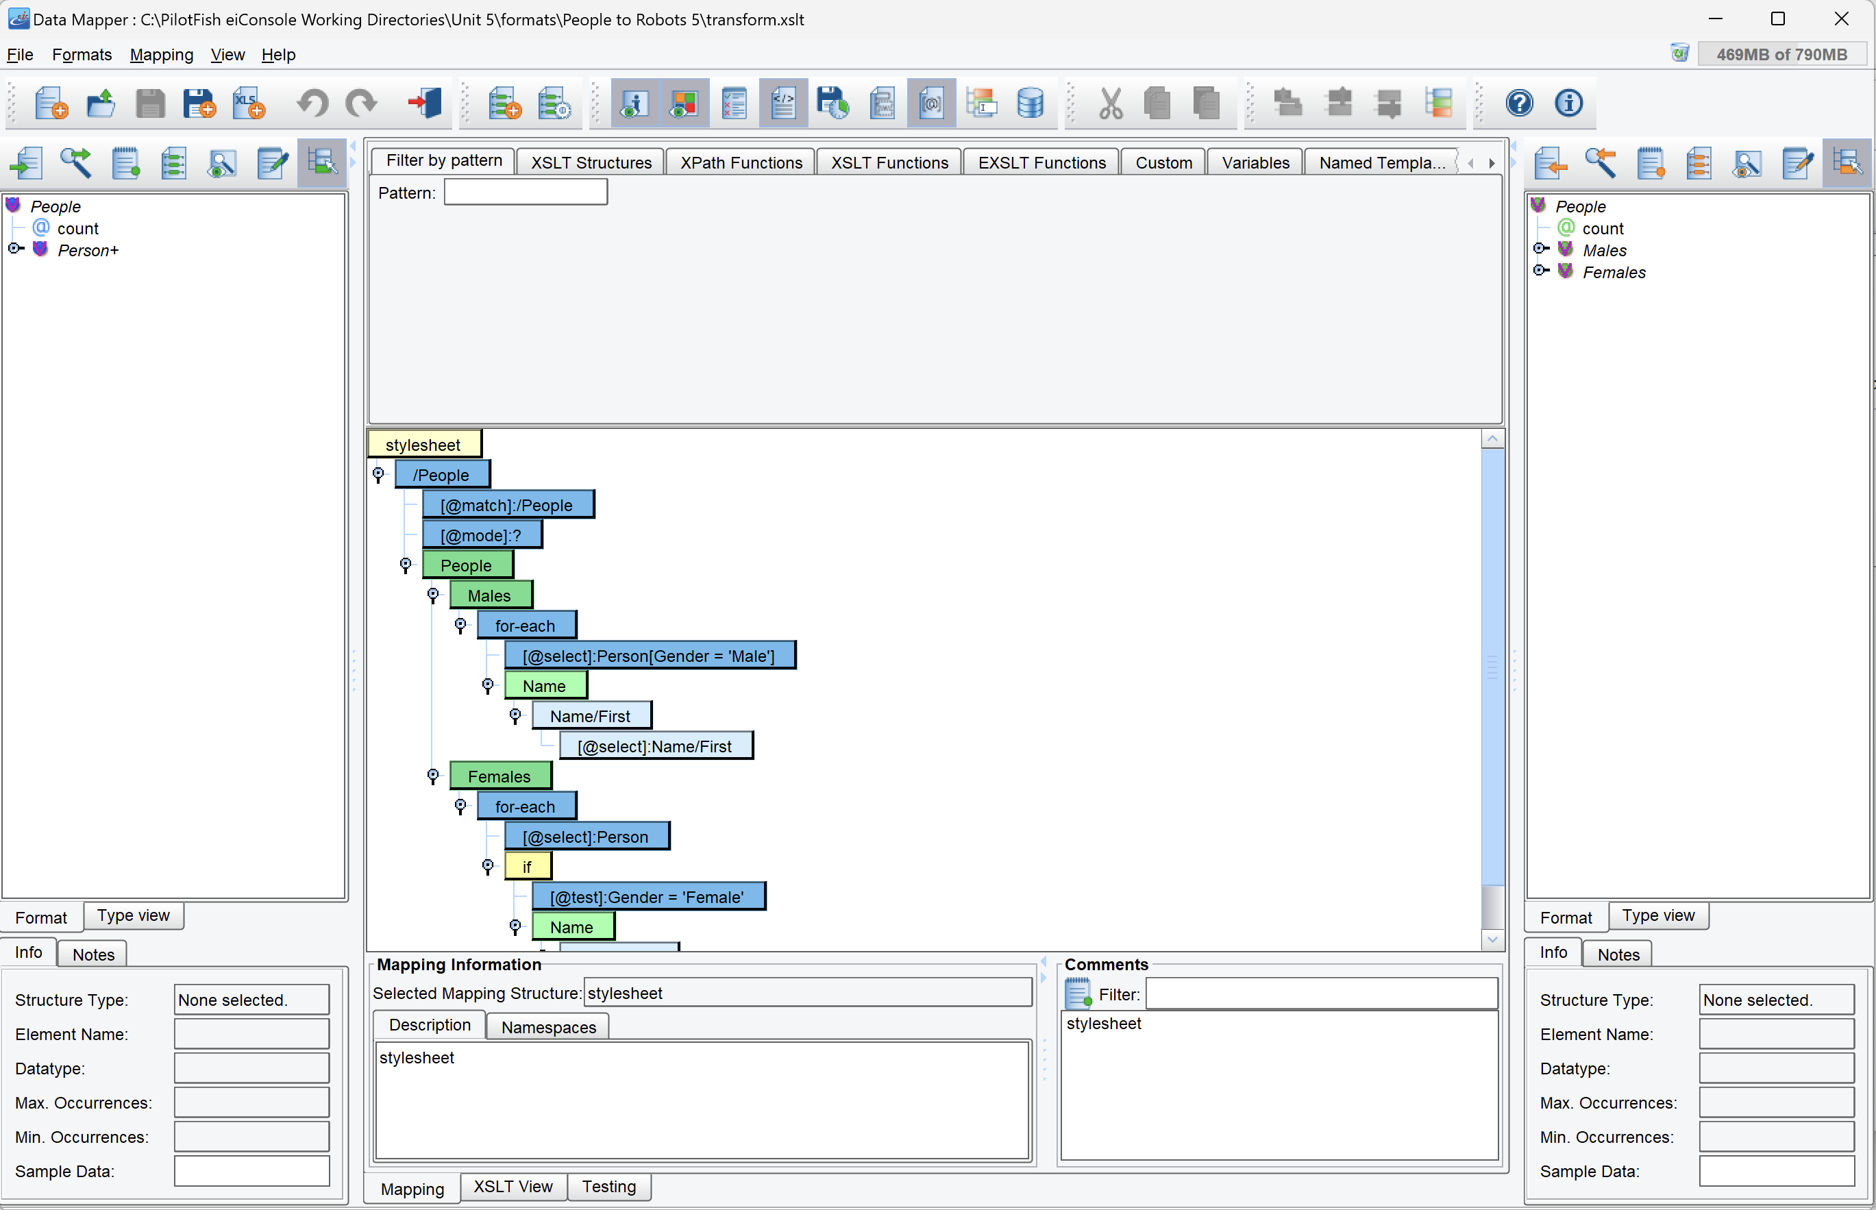
Conditions and Iteration

Slide 23
Conditions and Iteration
All the logic for iteration and conditions in XSLT can be found in the top tools palette, including for-each, if, and choose/when/otherwise.
For for-each, the XPath expression to iterate over is exposed via a child node called “@select”. A source node representing the XPath to iterate over should be dragged onto that “@select”, and it will be automatically populated with the necessary XPath.
For if and when, their conditions are exposed via a “@test” node. Filling in the boolean expression will generally be done the same way as adding a predicate, by double-clicking on it to open up its text field.

Slide 24
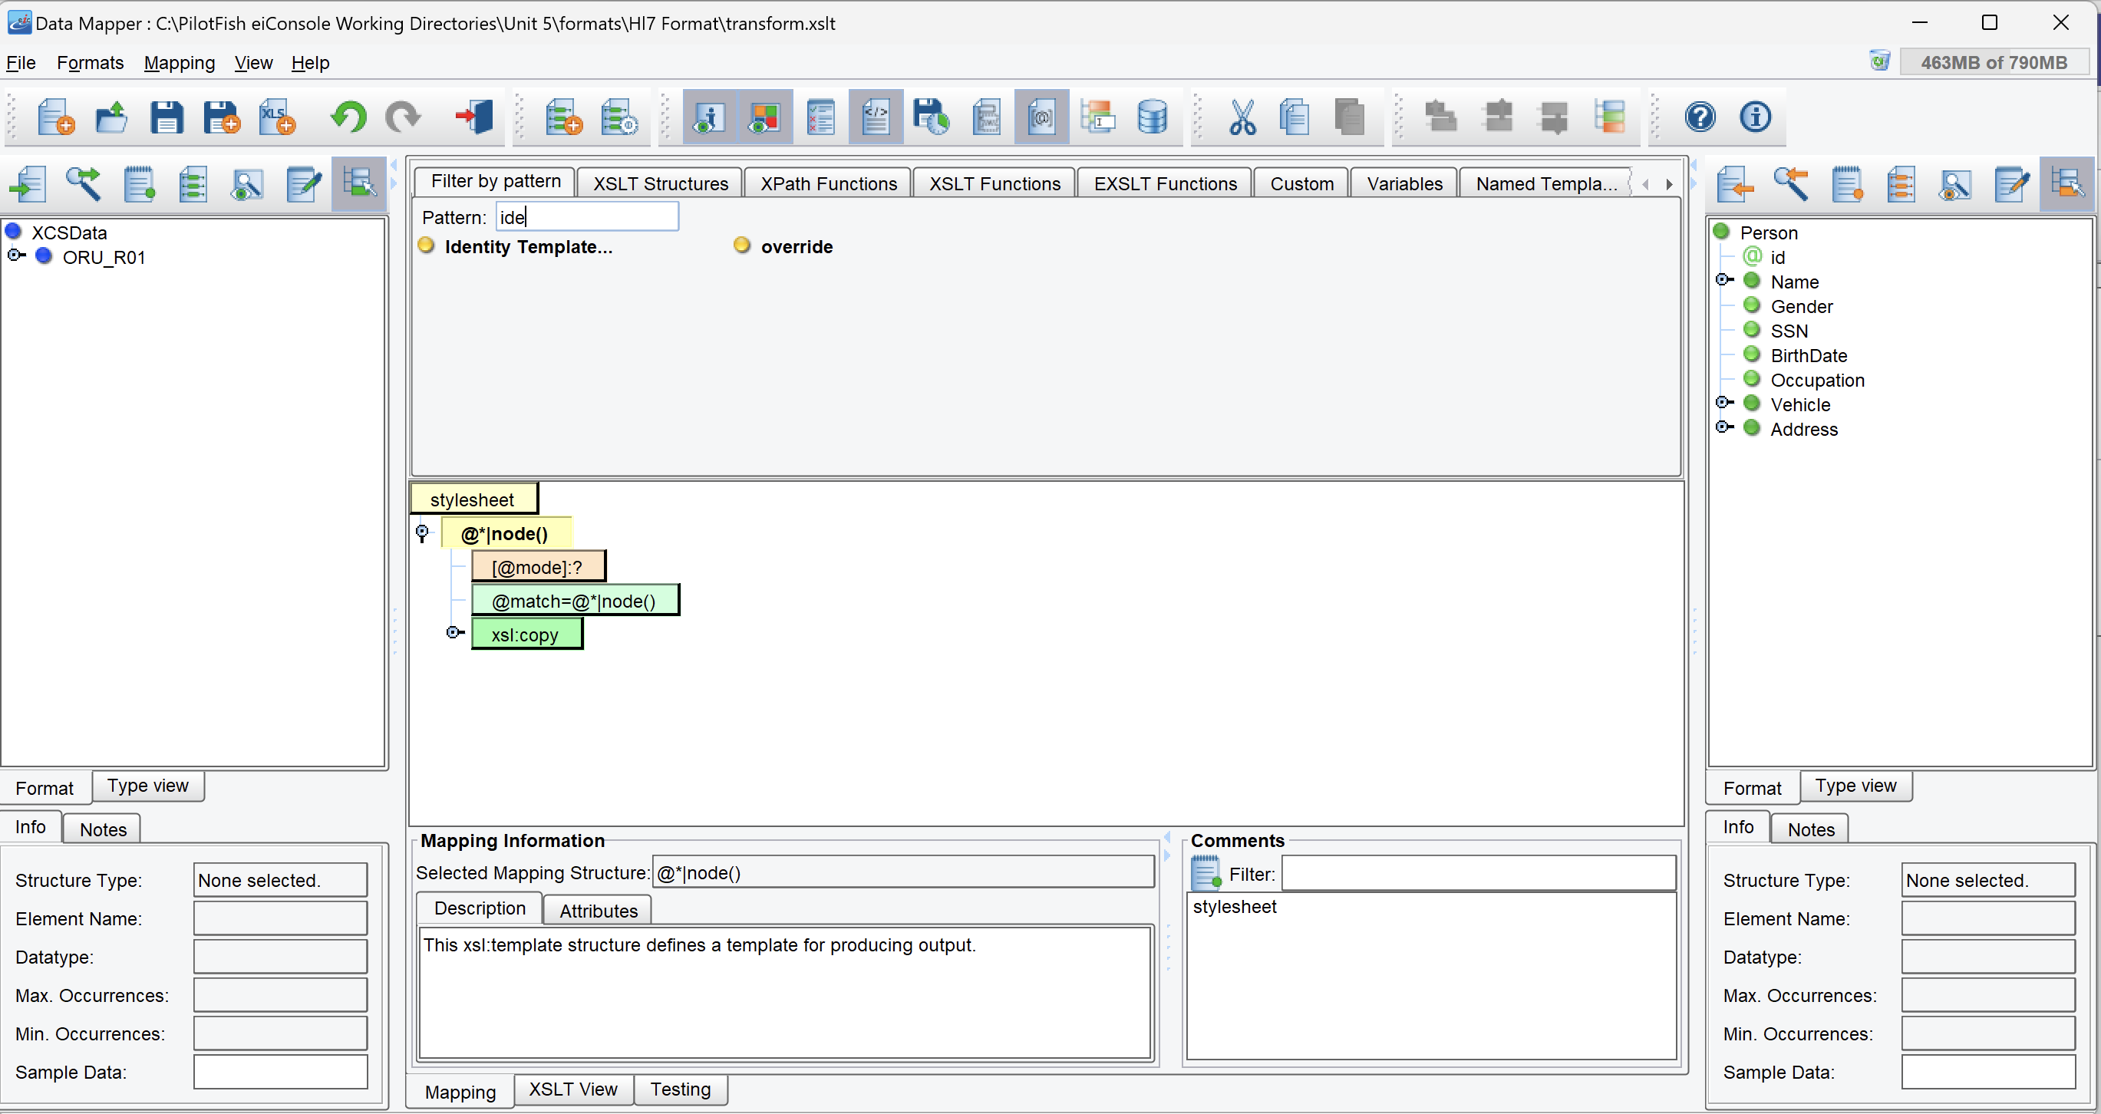
Variables and Parameters
Variables and Parameters can also be declared in the drag-and-drop in the same way as other tools, by dragging-and-dropping them from the tools palette.
A special feature of the Data Mapper is the Variables tab in the tools palette, which shows what variables are available for use. It filters the variables based on what node is selected in the center mapping, so make sure that the place the variable is to be used is selected, because it will only be displayed if it is valid there.

Slide 25
Identity Transformations
The Identity Transformation can be done in the Data Mapper by finding the “Identity Template” node in the tools palette. Dragging-and-dropping it onto the center mapping automatically populates the full logic of an Identity Transformation.
Additional templates can then be added normally through drag-and-drop following the normal Identity Transform process.

