Slide 1
Product Training Program
Unit 8 - SQLXML

Slide 2
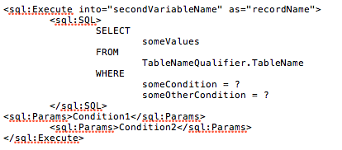
SQLXML

Slide 3
What is SQLXML?
SQLXML is an XML evaluation and execution mechanism, that uses XML to provide instructions about how to execute SQL statements.
SQLXML provides helper constructs for performing simple SQL operations in a database-agnostic way, as well as the ability to wrap complex literal SQL queries.
SQLXML can be parameterized safely, protecting against SQL Injection.
PilotFish SQL database components expect to be provided with SQLXML when they execute.
For more details, please consult the SQLXML User Guide.

